Slide 1
Introduction to Oracle9i Reports Developer
Notes:
Schedule: Timing Topic
<xx> minutes Lecture
<xx> minutes Practice
<xx> minutes Total

Slide 2
Objectives
After completing this lesson, you should be able to do the following:
  Describe business intelligence
  List the benefits of enterprise reporting
  Describe the differences between Web publishing and paper publishing
  Describe the key features of Oracle9i Reports Developer
  Describe the architecture of Oracle9i Application Server
  Describe Oracle9iAS Reports Services

Slide 3

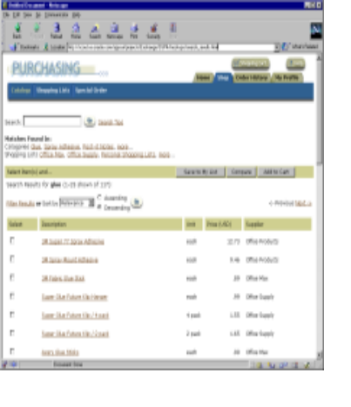

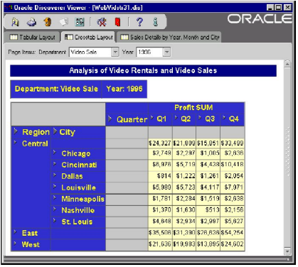

Business Intelligence
Discoverer Server
Reports Server
XML

Slide 4




Enterprise Reporting
  Provides access for more users to vital customized information
  Lowers cost of ownership
  Uses integrated business intelligence
Web
Application
Server
Data Server
Any
Client

Slide 5

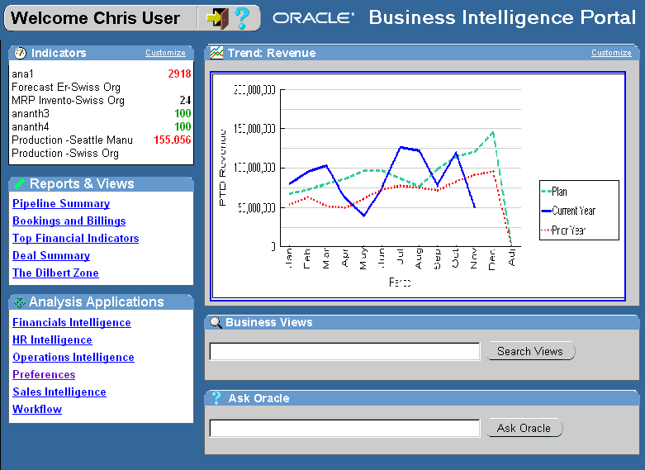

Enterprise Reporting
Reporting
Ad hoc query
Advanced
analysis
Web Client
Data Server
Application Server

Slide 6
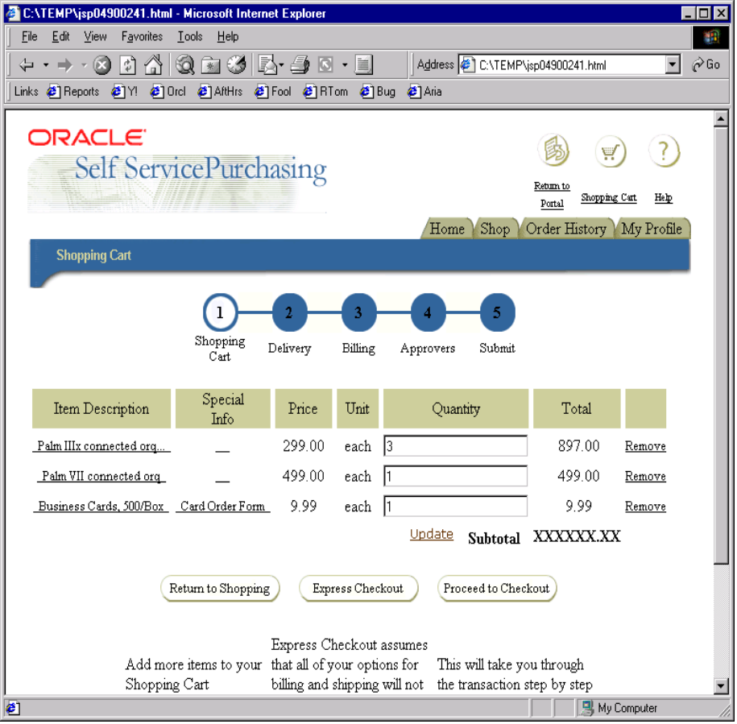


Web Publishing
GIF89a
hyperlinks
JavaScript

Slide 7


Paper Publishing
8.5”
GIF89a
hyperlinks
11”
JavaScript

Slide 8
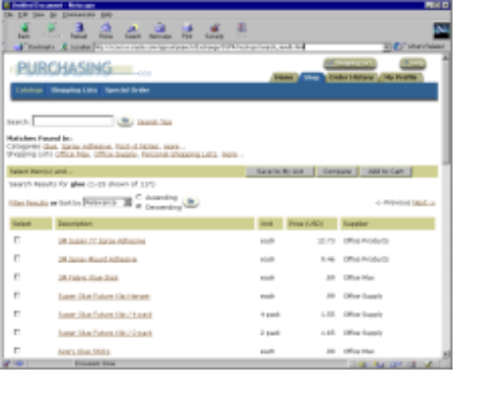









Oracle9i Reports Developer
Publish data from any source, in any format, to any destination with high fidelity.
<TEXT>
<Your Data Source>

Slide 9
Benefits
  Publish data from any source, in any format, with high fidelity
  Develop one time and deploy anywhere
  Open, standards-based, modular architecture

Slide 10



Oracle9i Products
  Oracle9i provides the complete solution:
  Oracle9i Database
  Oracle9i Developer Suite
  Oracle9i Application Server

Slide 11






Oracle9i Database
Oracle9i Database manages all of your data:
Relational Data
Documents
Multimedia

Slide 12
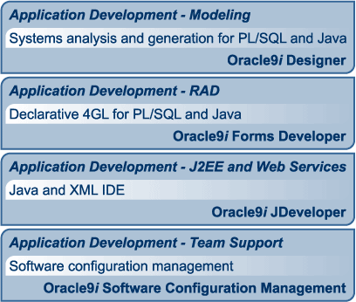
Oracle9iDS Application Development

Slide 13
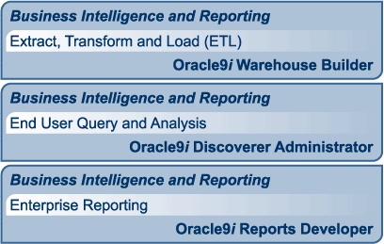
Oracle9iDS Business Intelligence

Slide 14
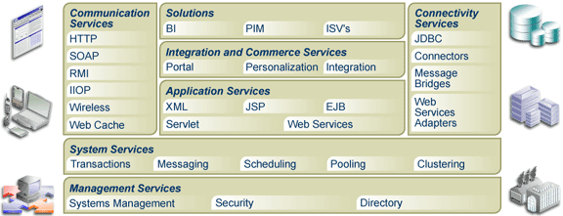
Oracle9i Application Server

Slide 15
Features of Reports Developer
  User-friendly wizards
  Pluggable data sources
  Customizable report templates
  WYSIWYG live editor for paper reports
  Dynamic Web publishing using JSP/HTML
  Run-time customization
  Dynamic SQL execution
  Portal integration
  Event-based reporting

Slide 16
Oracle9iAS Reports Services
  Flexible reporting
  Reduced overhead
  Fast distribution
  Real time publishing

Slide 17
Oracle9iAS Reports Services Architecture
HTTP
Oracle HTTP Listener
mod_OC4J
JSP Engine
Oracle Internet Directory
CORBA/IIOP
CORBA/IIOP
Oracle9iAS
Reports Services
Reports
Engine
PDS

Slide 18
Summary
  In this lesson, you should have learned how to:
  Describe integrated business intelligence
  List the benefits of enterprise reporting
  Describe the challenges of publishing for different media
  List the Oracle9i products
  List the key features and benefits of Oracle9i Reports Developer
  Describe Oracle9iAS Reports Services

